Slide 1
Topic
Data analysis:
Analysis and prediction of student’s academic performance
*A development project: using R programming language.

Slide 2
Acknowledgements
Roles | Name & Title
Author | Zhiying Zhou (Data science major)
Academic Supervisor | Guido Zuccon (Lecturer)

Slide 3
Contents
1.Introduction:
1.1 Background
1.2 motivation
1.3 Objective, Deliverables
2.Overall project methodology :
3.Project management approach :
2.1 Project approach
2.2 Project Controlling Approach
2.3 Risk

Slide 4
1. Introduction
Background
Data analysis has been widely used in various fields like marketing, medicine, real estate, customer relationship management, engineering, web mining etc.
Educational data analysis is a new emerging technique, data analysis can be applied on the education data sets. There are increasing research interests in using data analysis in education.

Slide 5
Motivation
Examination plays a vital role in any student's life. The marks obtained by the student in the examination decide his future. Therefore, it becomes essential to predict whether the student will pass or fail in the examination.
If the prediction says that a student tends to fail in the examination prior to the examination then extra efforts can be taken to improve his studies and help him to pass the examination.
It’s very useful for students, schools and parents,

Slide 6
Introduction of this project:
The dataset consists of 480 student records and 16 features. The features are classified into three major categories:
(1) Demographic features such as gender, grade levels, topic and nationality.
(2) Academic background features such as educational stage, grade Level and section.
(3) Behavioral features such as raised hand on class, opening resources, answering survey by parents, and school satisfaction.
The students are classified into three numerical intervals based on their total grade/mark: Low-Level, Middle-Level, High-Level

Slide 7
What I will do :
Using Studio R to analyse this datasets in R programming language
Targets:
Exploration of the datasets. Distribution of the data in different features: gender, nationality, grade, topic, parent…… (like girls raises more hand, more discussions in high school)
Find underlying relationships. Like parent who are not satisfied and not answer survey, connection with study activity and performance (raising hand, absence, content)
Build prediction model, like decision tree or neural network to predict the student’s academic performance.

Slide 8
Objectives:
Decision trees model can successfully identify the students who are likely to fail. These students can be considered for proper counseling so as to improve their result.
The model can be easily integrated into a recommender system that can help students in their course selection, based on their and other graduated students’ grades.
The datasets used in this project is just a sample, we can use the same method to analyze all kinds of educational performance to suit all kinds of students in different grade levels, gender, nationality, and even suitable for university student.

Slide 9
Deliverables
There will be 2 main types of deliverables in this study:
1. A final report that contains all the details of the analysis and prediction on the dataset.
2. One single zip archive folder which contains the following files in this study, including Rmarkdown file, Rmarkdown in PDf and HTML format, which will show the visualization of the analysis results of the dataset, and the student’s academic performance dataset.

Slide 10
2. Overall project methodology
Project approach
Problems | Project methodology
Is it feasible to get useful results by using data analysis method to analyze the student’s academic performance. | Analysis of background: Data analysis in educational datasets Data analysis methods What did people do on this area(previous work). How did they do
How can we process and ananlyse? | Implementation: Using R programming language to develop a program: 1. Exploration of the datasets. Distribution of the data in different features: gender, nationality, grade, topic, parent. 2. Find underlying relationships. Like parent who are not satisfied and not answer survey, connection with study activity and performance. 3. Build prediction model, like decision tree or neural network to predict the student’s academic performance.
What kind of outcome we can get from the results? | Evaluation and improvement: Based on the analysis results, test and evaluate the results to ensure the quality of the analysis

Slide 11
3.Project Management Approach
Waterfall software development methodologies are good for small projects that contain clear requirements
1. Planning and Requirements.
2. Design and modeling the project.
3. Follow the plan to develop the R program to analyse and predic the datasets. 4. Test and evaluate the results to ensure the quality of the project.
5. Analyse, evaluate and improvement.
Also make gan chart Project Gantt Chart to manage the project an control risk

Slide 12
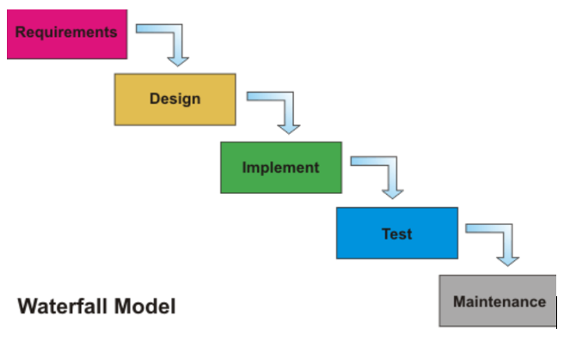

Slide 13
Key stakeholders
Stakeholder | Involvement
Student | Develops the project.
Academic Supervisor | Provides guidelines and recommendations.
Project Coordinator (Marker) | Gives feedback on presentation of the project plan. Assesses the progress of the project.

Slide 14
Project Controlling
Project Timeline
Project Phases | Milestone | Due Date | Duration
Introduction | Project Proposal presentation | 10th Aug | 3 weeks
Planning | Final project proposal submission | 20th Aug | 1 week
Literature Review | Review literatures to find out what has been researched about educational performance and what the methods they used. Explore the student’s academic performance dataset, and find out what can be done using R on these datasets. | 27th Aug | 1 week
Development | Based on the knowledge, developing the R code to analyse and predict the student’s academic performance. | 24th Sep | 4 weeks
Revise and Summarize the results | Revise the R code and make summary of the conclusions of the analysis and prediction. | 15th OCT | 2 weeks
Evaluation | Final presentation | 22th OCT | 2 weeks
 | Thesis submission | 29th OCT

Slide 15
Project Controlling
Communication Plan
Communication Type | Objective of Communication | Medium | Frequency | Audience | Deliverable
Project progress meeting | Review the progress and improvement for the next week | Meeting | Every week | Academic supervisor | Agenda meeting minutes
Phase Report | Summarize the progress and problems in each phase | Reporting | Phase | Academic supervisor & Project Team | Phased Report
Daily notice | Receive all the mission or seek help from academic supervisor | Communication in Slack | Casual | Academic supervisor & Project Team | Slack communication records
Final | Represent all outcome of this project | Meeting | Final | All stakeholders | Project Report

Slide 16
Project Controlling
Project Risk Assessment
Risk Description | Impact | Likelihood | Mitigation strategy
Have some difficulties in programming in R language for some complicated problems | Medium | High | -- Seek the similar problems online and find out the solutions. -- Communicate the problems with the project team timely and solve it together. -- Seek help from teachers.
The time for the development of the project is relatively short what may cause that not all the features are delivered. | Medium | Low | -- Prepare project plan -- Manage the project in different phases -- Follow the timetable of the project plan
Not enough cooperation with project team | Low | Medium | -- Build communication plan -- Routine meeting

